Slide 1
Current Expected Credit Losses (CECL) Vintage analysis & PD*LGD models
Members
Willies Mboko *
Tharun Kalyan Polamarasetty*
Tianyu Cheng
Xu Yan

Slide 2
0. Outline
Introduction
Vintage Analysis
Probability of Default (PD)* Loss Given Default model(LGD)
Conclusion

Slide 3
1. Introduction
FASB
Financial Accounting Standards Board
ALLL* – Past
Relies on incurred losses
Weakneses
Factors in past info only
No gradual build-up in reserve
No macroeconomic impact
CECL – Future
Expected losses over the life of the loans
Methodologies
PD x LGD method
Vintage
Loss Rate
Discount Cash Flow
Roll Rate
*Allowance for Loan and Lease Losses

Slide 4
2. Vintage Analysis
 | Originations ($ ‘000) |  |  | Loss Rates (LR)
 |  | 0 | 1 | 2 | 3 | 4 | 5 | 6 | 7
2010 | 432,393,318 | 0.00% | 0.07% | 0.13% | 0.13% | 0.11% | 0.09% | 0.07% | 0.06%
2011 | 357,655,983 | 0.00% | 0.06% | 0.12% | 0.12% | 0.09% | 0.08% | 0.08% | 0.06%
2012 | 608,102,601 | 0.00% | 0.04% | 0.07% | 0.08% | 0.07% | 0.07% | 0.06% | 0.06%
2013 | 483,418,875 | 0.00% | 0.07% | 0.12% | 0.13% | 0.13% | 0.07% | 0.06% | 0.06%
2014 | 310,374,245 | 0.01% | 0.12% | 0.23% | 0.25% | 0.08% | 0.07% | 0.07% | 0.06%
2015 | 421,060,907 | 0.01% | 0.12% | 0.25% | 0.11% | 0.08% | 0.07% | 0.06% | 0.06%
2016 | 540,648,337 | 0.01% | 0.16% | 0.11% | 0.11% | 0.09% | 0.07% | 0.07% | 0.06%
2017 | 389,973,069 | 0.03% | 0.06% | 0.11% | 0.11% | 0.08% | 0.07% | 0.07% | 0.06%
 | Avg LR | 0.01% | 0.09% | 0.15% | 0.14% | 0.10% | 0.08% | 0.07% | 0.06%
 | Avg LR/Q | 0.13% | 1.58% | 2.89% | 2.90% | 2.21% | 1.86% | 1.74% | 1.56%
 | Originations ($ ‘000) |  |  | Q Factor - Unemployment
 |  | 0 | 1 | 2 | 3 | 4 | 5 | 6 | 7
2010 | 432,393,318 | 8.93% | 8.08% | 7.36% | 6.16% | 5.28% | 4.88% | 4.35% | 3.89%
2011 | 357,655,983 | 8.08% | 7.36% | 6.16% | 5.28% | 4.88% | 4.35% | 3.89% | 3.70%
2012 | 608,102,601 | 7.36% | 6.16% | 5.28% | 4.88% | 4.35% | 3.89% | 3.70% | 3.70%
2013 | 483,418,875 | 6.16% | 5.28% | 4.88% | 4.35% | 3.89% | 3.70% | 3.70% | 3.90%
2014 | 310,374,245 | 5.28% | 4.88% | 4.35% | 3.89% | 3.70% | 3.70% | 3.90% | 3.70%
2015 | 421,060,907 | 4.88% | 4.35% | 3.89% | 3.70% | 3.70% | 3.90% | 3.70% | 3.80%
2016 | 540,648,337 | 4.35% | 3.89% | 3.70% | 3.70% | 3.90% | 3.70% | 3.80% | 3.80%
2017 | 389,973,069 | 3.89% | 3.70% | 3.70% | 3.90% | 3.70% | 3.80% | 3.80% | 3.75%

Slide 5
2. Vintage Analysis
 | Originations ($ ‘000) |  |  | Size of Defaults ($ ‘000)
 |  | 0 | 1 | 2 | 3 | 4 | 5 | 6 | 7
2010 | 432,393,318 | 13,424 | 298,429 | 580,751 | 582,579 | 491,864 | 380,771 | 288,129 | 262,766
2011 | 357,655,983 | 13,906 | 212,883 | 415,410 | 419,964 | 335,237 | 291,826 | 275,895
2012 | 608,102,601 | 18,458 | 236,058 | 451,114 | 469,265 | 444,376 | 454,670
2013 | 483,418,875 | 16,775 | 323,642 | 565,608 | 638,405 | 611,323
2014 | 310,374,245 | 18,301 | 373,385 | 719,136 | 775,415
2015 | 421,060,907 | 23,287 | 500,123 | 1,052,960
2016 | 540,648,337 | 39,159 | 849,333
2017 | 389,973,069 | 127,489
 | Loss Rates
 | Actual | Expected | Error
2010 | 0.07% | -
2011 | 0.07% | 0.06% | -22%
2012 | 0.08% | 0.06% | -21%
2013 | 0.13% | 0.07% | -48%
2014 | 0.25% | 0.08% | -67%
2015 | 0.29% | 0.11% | -63%
2016 | 0.31% | 0.11% | -65%
2017 | 0.27% | 0.06% | -78%
High Error rates
Many problems with the methodology – Top 3
Overparameterization
Extreme model sensitivity to Q factor selection
No tail factors

Slide 6
3. PD * LGD model
Data Used:
Fannie Mae Single Family Loan data
Used California State data from 2005 to 2015
Economic indicator data sourced from Bloomberg and the Fed reserve
10 economic variables including GDP, HPI, CPI among others
Models used:
PD – Probability Transition Matrix
LGD – Beta-Regression

Slide 7
PD Model
Process applied
Used a probability transition matrix to estimate the model.
The transaction matrix is based on a conditional Markov chain model
Applied a logistic regression with L2 penalty to estimate probabilities
After obtaining the matrix, we calculated the probability of eventual default by multiplying the matrix over the loan term

Slide 8
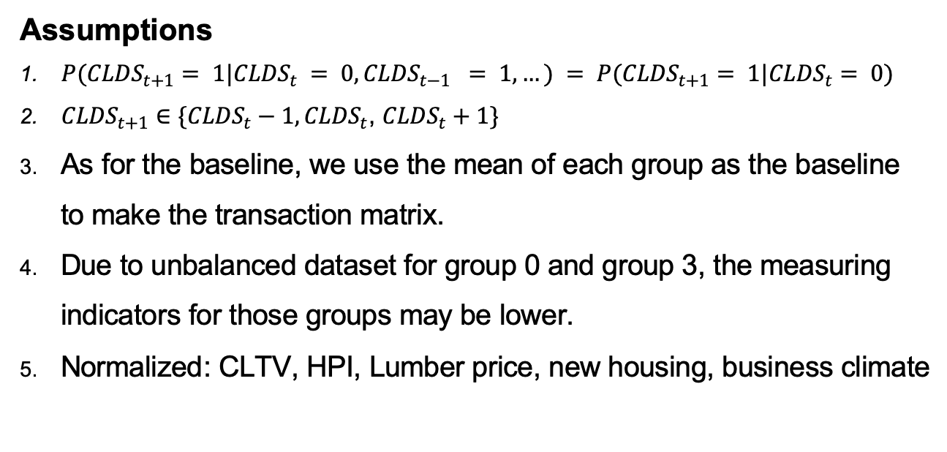
PD Model
Assumptions
$P({CLDS}_{t+1}= 1|{CLDS}_{t} = 0, {CLDS}_{t−1} = 1,…) = P({CLDS}_{t+1}= 1|{CLDS}_{t}= 0)$
${CLDS}_{t+1}∈\{{CLDS}_{t}−1,{CLDS}_{t}$, ${CLDS}_{t}+1\}$
As for the baseline, we use the mean of each group as the baseline to make the transaction matrix.
Due to unbalanced dataset for group 0 and group 3, the measuring indicators for those groups may be lower.
Normalized: CLTV, HPI, Lumber price, new housing, business climate

Slide 9
PD Model
Select Variables
PD Transition Matrix →
Key
-1 – Prepayment
0 – 4 - Months in delinquency
D - Default
 | -1 | 0 | 1 | 2 | 3 | D
0 | 0.016 | 0.980 | 0.004
1 |  | 0.361 | 0.451 | 0.188
2 |  |  | 0.133 | 0.417 | 0.451
3 |  |  |  | 0.064 | 0.248 | 0.689
Business Climate coefficients
 | -1 | 0 | 1
0 | 0.056 | -0.018 | -0.074
1 | 0.273 | -0.126 | -0.261
2 | 0.058 | -0.019 | -0.040
3 | 0.013 | -0.011 | -0.024
CLTV coefficients
 | -1 | 0 | 1
0 | -0.155 | -0.152 | 0.308
1 | -0.350 | -0.095 | 0.360
2 | -0.162 | -0.028 | 0.190
3 | -0.136 | -0.014 | 0.150

Slide 10
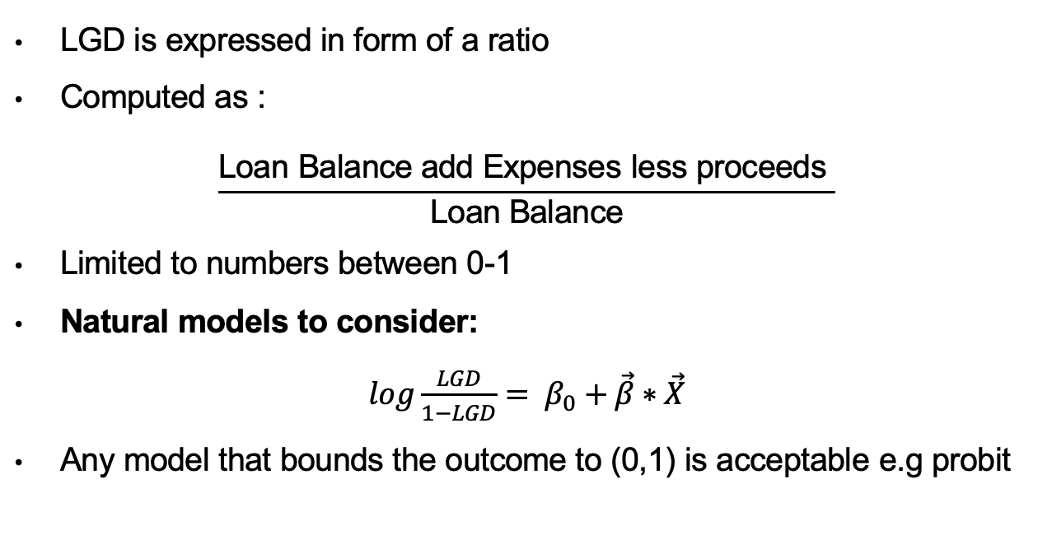
LGD Model
LGD is expressed in form of a ratio
Computed as :
$$\frac{\text{Loan} \text{Balance} \text{add} \text{Expenses} \text{less} \text{proceeds} }{\text{Loan} \text{Balance}}$$
Limited to numbers between 0-1
Natural models to consider:
$log\frac{LGD}{1−LGD}= β_{0}+\vec{β}∗\vec{X}$
Any model that bounds the outcome to (0,1) is acceptable e.g probit

Slide 11
LGD Model
We tested 2 models for viability, fractional response(FR) logistic regression and beta regression
Outputs
Beta regression performs much better than FR
The reason lies in the assumptions; Beta takes on continuous values while the FR regression has an implicit binary assumption (0 or 1)
 | R²
FR logistic regression | 0.096
Beta regression | 0.219

Slide 12
LGD Model
LGD is a bimodal distributions → explains low R² from before
Inspecting the zero-balance code shows that 6(Repurchases) and 16(Reperforming loans) consistently have LGD’s at 1
Adjusting for this and re-running the Beta regression from before we get an R² of 0.630

Slide 13
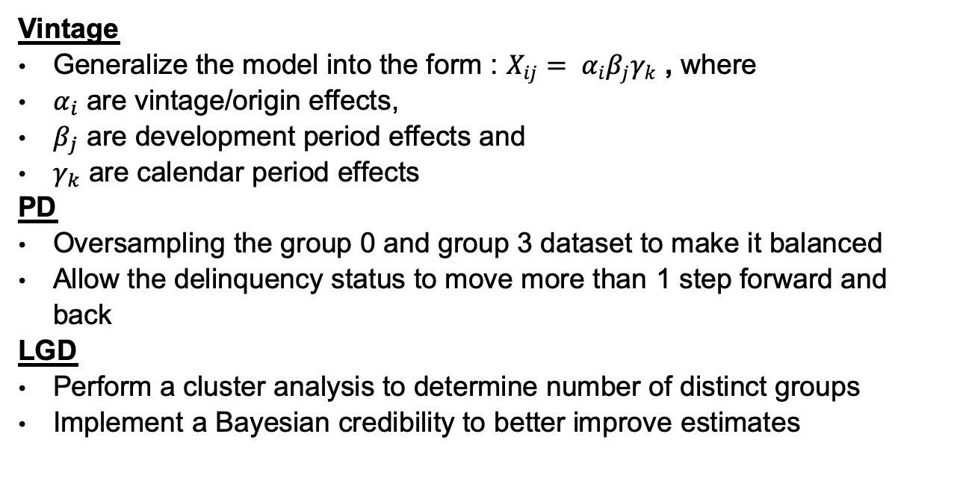
4. Potential Improvement
Vintage
Generalize the model into the form : $X_{ij}= α_{i}β_{j}γ_{k}$ , where
$α_{i}$ are vintage/origin effects,
$β_{j}$ are development period effects and
$γ_{k}$ are calendar period effects
PD
Oversampling the group 0 and group 3 dataset to make it balanced
Allow the delinquency status to move more than 1 step forward and back
LGD
Perform a cluster analysis to determine number of distinct groups
Implement a Bayesian credibility to better improve estimates

Slide 14
Thank You
Q & A

Slide 15
Model Measurement Indicator
CLDS Group | Precision | Recall | F1 Score
0 | 0.326/0.326 | 0.33/0.33 | 0.33/0.33
1 | 0.49/0.48 | 0.40/0.39 | 0.37/0.36
2 | 0.40/0.39 | 0.37/0.37 | 0.34/0.34
3 | 0.227/0.225 | 0.33/0.33 | 0.27/0.27

Slide 16
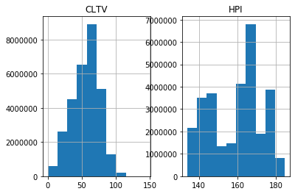
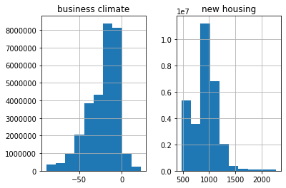
Histogram

Slide 17
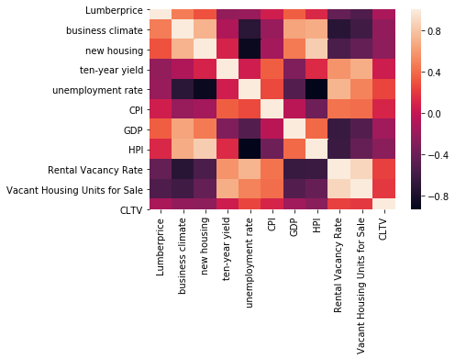
Correlation Heatmap

Slide 18
Diagnostic Graph for LGD

